Slide 1

PromptForge: From Zero to $50K MRR in 4 Weeks
4
$54K
Weeks to Launch
Total Budget
5
$50K
Fast-Track Blueprint for Aggressive MVP Launch and Revenue Generation
Person Team
MRR Target
January 2026
PromptForge Stakeholder Review

Slide 2
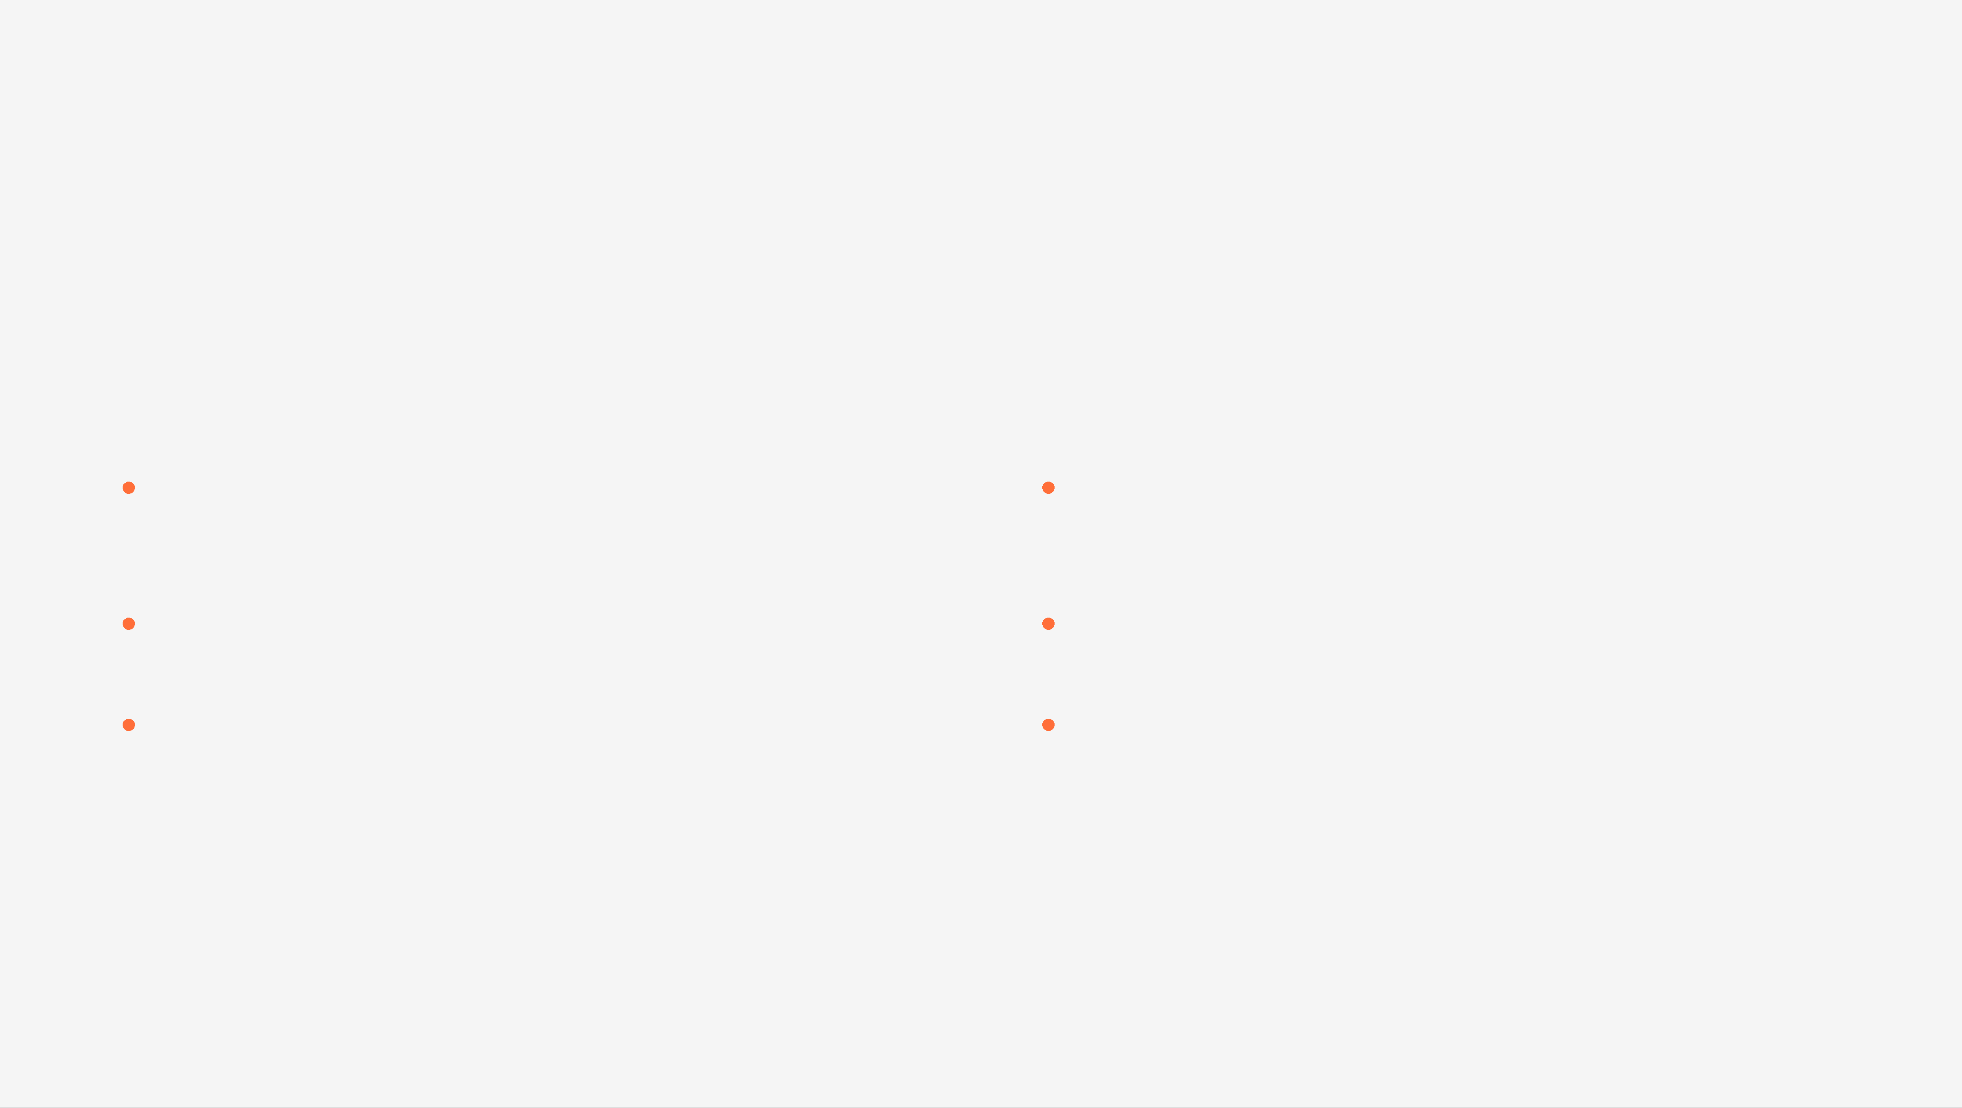
Why Now? Market Timing & Competitive Advantage
Market Opportunity
Competitive Advantage
Prompt Engineering Tools
Structured Paths
Companies spending millions on prompt optimization and AI workflow development
60-pack ecosystem guides users to profitable digital assets, not blank canvas
SaaS Development
Content Moat
Founders need faster ways to build and monetize digital assets
Comprehensive pack library creates defensible competitive advantage
Automation Demand
Market Timing
Teams desperate for tools that reduce manual work and increase efficiency
12-month window to capture market share before competitors catch up
Key Insight
AI adoption is at all-time high. Founders actively seeking tools to accelerate workflows. Willingness to pay for productivity tools has never been higher. We need to move now.

Slide 3
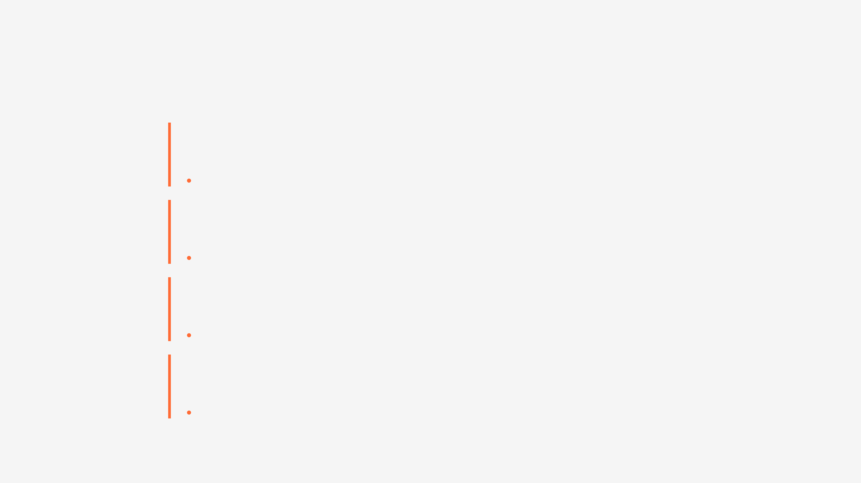
The 4-Week Timeline: Week-by-Week Execution
Week 1
Foundation & Launch Prep
Infrastructure setup, backend/frontend development, authentication, pack execution engine
Days 1-7
500+ email subscribers, landing page live
Week 2
Launch & Early Traction
Soft launch with 50 beta users, Product Hunt launch, momentum and optimization
Days 8-14
50-100 paying customers, $5K-10K MRR
Week 3
Scale & Monetize
Affiliate program launch, pack library expansion, mobile app launch, enterprise deals
Days 15-21
200-300 paying customers, $20K-50K MRR
Week 4
Optimize & Prepare for Scale
Analytics dashboard, security hardening, compliance, Phase 2 planning
Days 22-28
300-500 paying customers, $30K-50K MRR

Slide 4
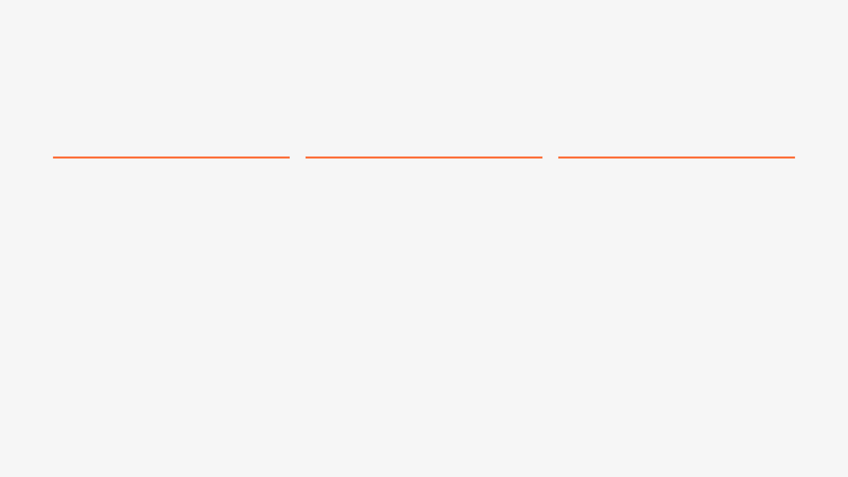
Lean MVP Specification: Core Features Only
Core Features
Expanded Features
Deferred
Week 1-2
Week 3
Phase 2
✓
User Authentication
✓
Visualisation Gen
✕
AI Agent Automation
✓
Pack Execution
✓
Pack Library (40+)
✕
Advanced Visualisation
✓
Pack Composer
✓
Mobile App
✕
Desktop App
✓
Execution History
✓
Team Collaboration
✕
Multi-Language
✓
Credit System
✕
Advanced Integrations
✓
Subscription Mgmt
✕
Pack Marketplace
✓
Basic Dashboard
✕
Community Features
Scope Discipline
We're building exactly what we need to validate product-market fit and generate revenue. Everything else waits. This ruthless scope discipline is what allows us to ship in 4 weeks.

Slide 5
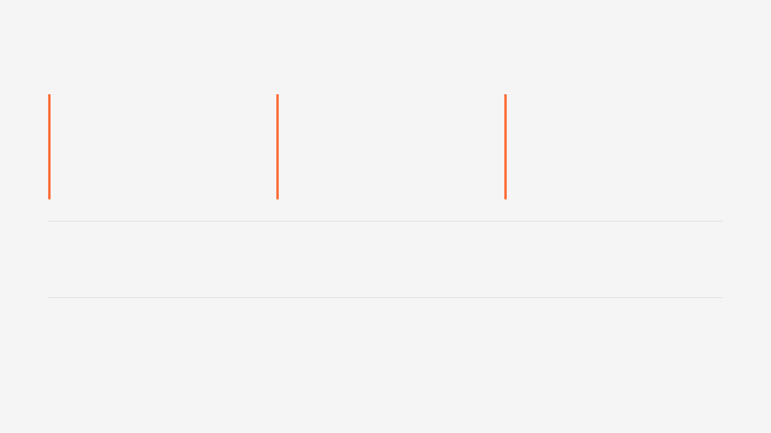
Revenue Model & Pricing: $30K-50K MRR Strategy
Free Tier
Pro Tier
Enterprise
$0
$29/mo
$500-5K/mo
10 executions/month
Unlimited executions
Custom features
Limited packs
All packs
SSO & security
Basic dashboard
Visualisation
Dedicated support
Purpose: Acquisition
Purpose: Monetisation
Purpose: Expansion
Week 2 Target
Week 3 Target
Week 4 Target
$5K-10K
$20K-50K
$30K-50K
10-20 paying customers
50-100 paying customers
200-500 paying customers
Target CAC
Target LTV
LTV:CAC Ratio
<$100
>$1000
>10:1
Customer Acquisition Cost
Lifetime Value
Highly Profitable
Customer Acquisition Channels
Direct Sales
Product Hunt
Affiliate Program
Content Marketing
Partnerships
Enterprise Sales

Slide 6
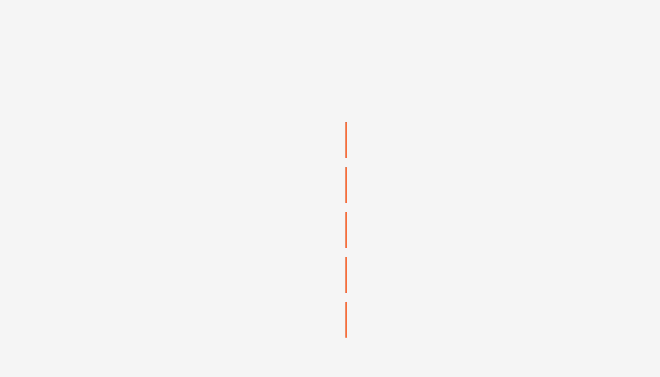
5-Person Lean Team: Roles & Execution Discipline
Team Structure
Execution Discipline
1. Founder/CTO
Daily Standups
Vision, Strategy, Sales
9 AM UTC, 15 minutes. What shipped, what's next, blockers
80% leadership, 20% technical
Non-negotiable
2. Backend Developer
Daily Priorities
API, Database, Integrations
Each person identifies top 3 priorities for the day
100% backend focus
Focus on shipping
3. Frontend Developer
Daily Shipping
Web UI, Mobile App, UX
At least one feature or fix shipped every day
100% frontend focus
Deploy to production daily
4. DevOps Engineer
Daily Metrics Review
5 PM UTC, 10 minutes. Users, revenue, bugs, progress
Infrastructure, Deployment, Security
Data-driven decisions
100% DevOps focus
Weekly Review
5. Growth/Marketing
Friday 5 PM UTC, 30 minutes. Recap, blockers, next week
Acquisition, Content, Partnerships
Continuous improvement
100% growth focus

Slide 7

$54K Total Investment: Budget Allocation
Personnel Costs
$45K
Infrastructure & Tools
$2K
83%
4%
Backend Developer: $15K (4 weeks)
AWS: $2K (compute, database, storage)
Frontend Developer: $15K (4 weeks)
Stripe: $0 (2.2% + $0.30 per transaction)
DevOps Engineer: $10K (4 weeks)
Vercel, GitHub, Sentry: $0 (free tier)
Growth/Marketing: $5K (4 weeks)
Marketing & Launch
$2K
4%
Landing page design: $1K
Social media content: $1K
Contingency (10%)
$5K
9%
Buffer for unexpected costs and overruns
Total Investment
$54K

Slide 8
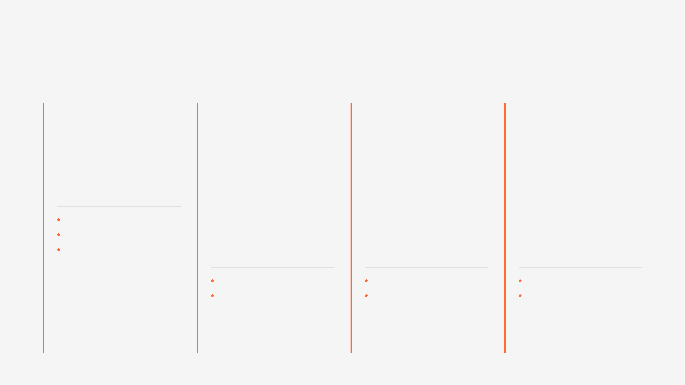
Week-by-Week Deliverables & Success Metrics
1
2
3
4
Foundation & Setup
Launch & Traction
Scale & Monetize
Optimize & Scale
Email Subscribers
Paying Customers
Paying Customers
Paying Customers
500+
50-100
200-300
300-500
Key Outcome
Monthly Revenue
Monthly Revenue
Monthly Revenue
$5K-10K
$20K-50K
$30K-50K
Infrastructure operational
Landing page live
MRR
MRR
MRR
Auth working end-to-end
Key Outcome
Key Outcome
Key Outcome
Ready to Launch
Product Hunt Top 5
Mobile app live
PMF confirmed
First paying customers
Enterprise deals closed
Ready for Phase 2
PMF Signals
Scaling
Target Achieved

Slide 9
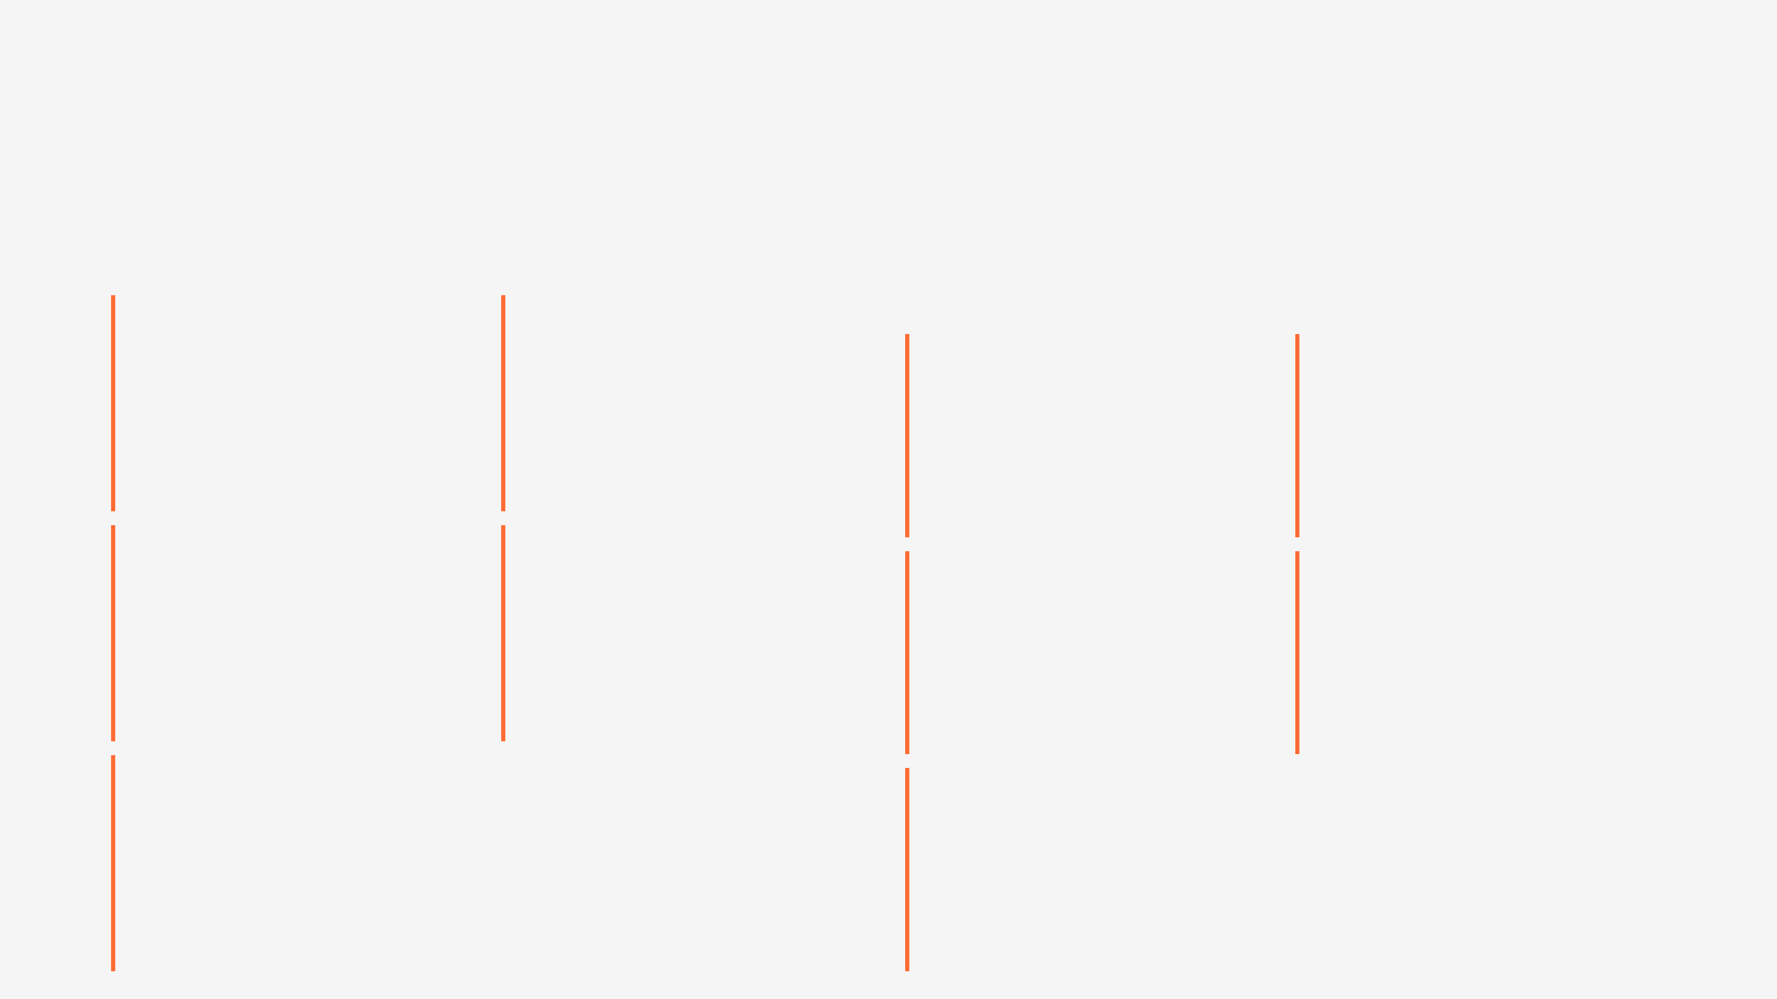
Risk Mitigation & 5 Critical Success Factors
Key Risks & Mitigation
5 Critical Success Factors
1. Team Burnout
2. Technical Debt
4-week sprint at max velocity could exhaust team
Rapid delivery may introduce bugs and security gaps
1. Execution Discipline
2. Product Quality
Daily standups, clear priorities, shipping every day
Ship fast but not broken. Security and performance matter
Mitigation:
Mitigation:
Daily 15-min standups, clear priorities, mandatory breaks
Automated tests, code reviews, security scans, monitoring
Critical
Critical
3. PMF Uncertainty
4. Competition
Product may not resonate with target market
Competitors may launch similar products during our 4 weeks
3. Customer Focus
4. Continuous Learning
Talk to customers daily and build what they need
Weekly retros, learn from failures, iterate on data
Mitigation:
Mitigation:
Daily customer feedback, weekly pivots, data-driven choices
Move fast, build a defensible moat, focus on execution
Critical
Important
5. Infrastructure Failure
5. Team Cohesion
Production outages could harm early customer trust
Small team aligned on trust, communication, vision
Mitigation:
Important
DevOps from Day 1, monitoring, backups, incident playbooks

Slide 10
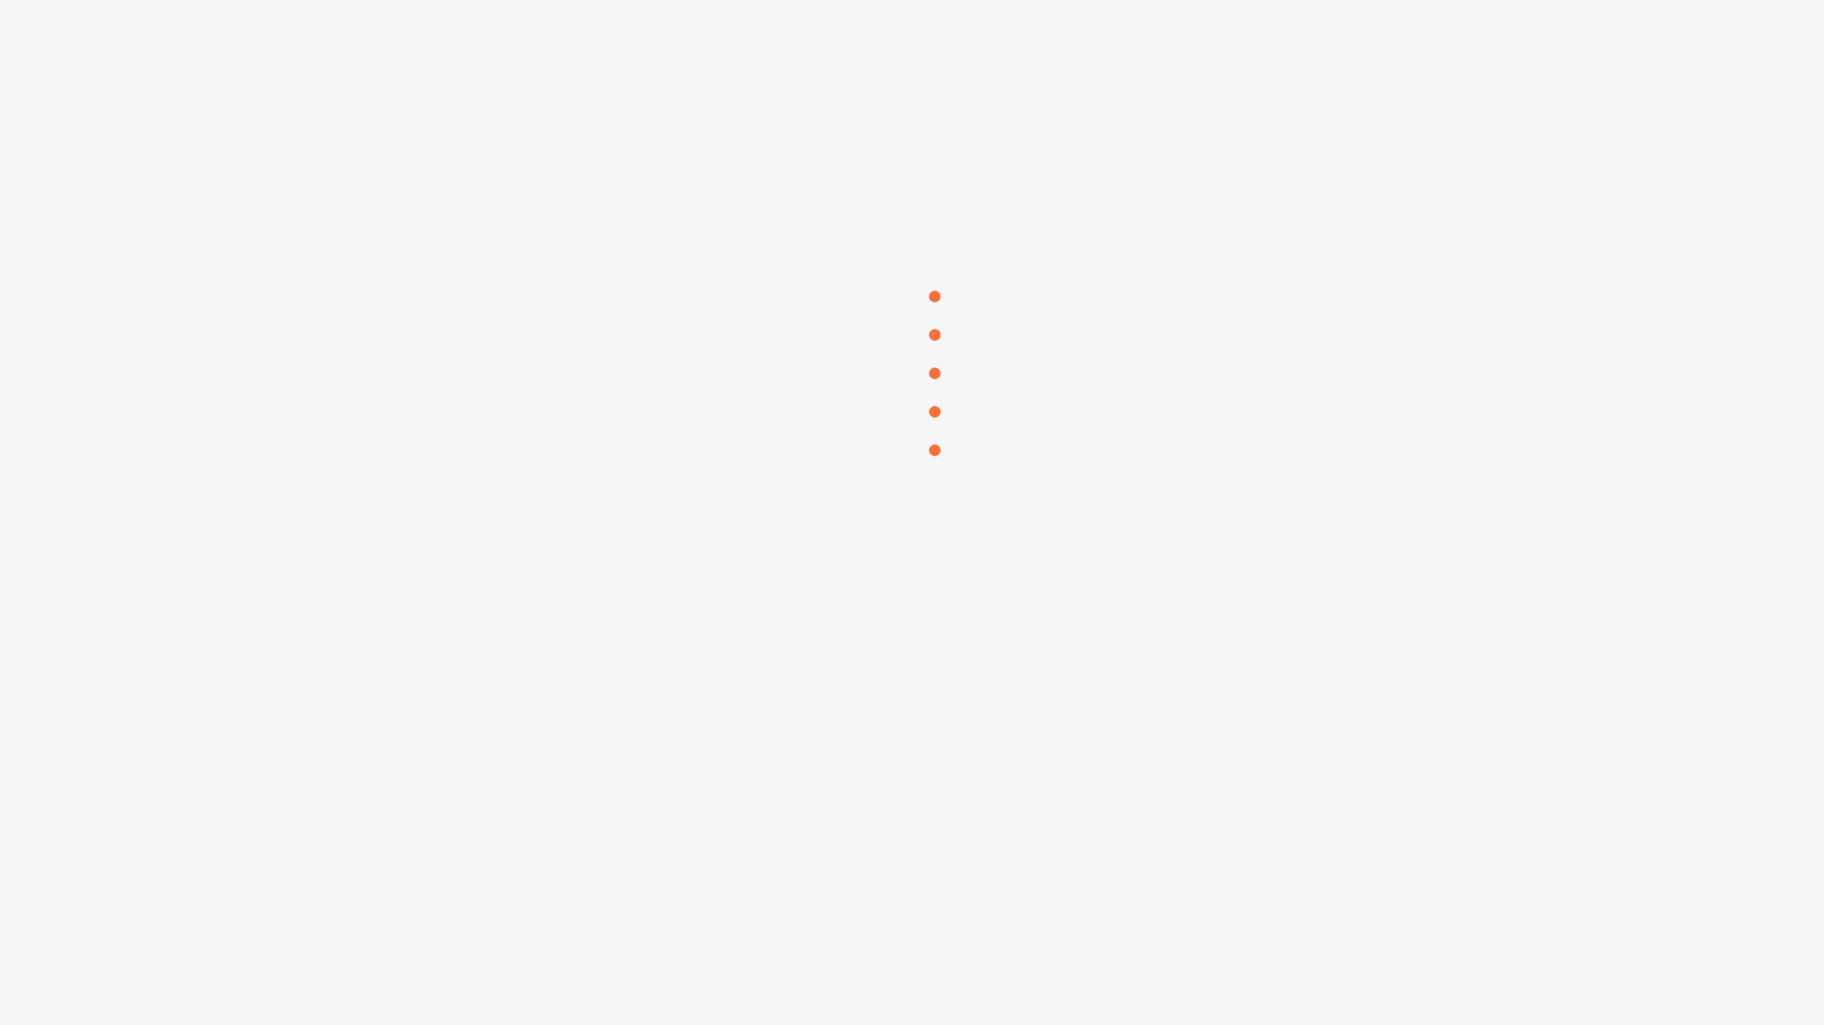
Next Steps & Call to Action
Immediate Actions Required
Week 1 Kickoff Plan
1
Secure Stakeholder Approval
Monday 9 AM
By End of This Week
Monday-Tuesday
2
Allocate $54K Budget
Wednesday-Thursday
By End of This Week
Friday 5 PM
3
Hire 5-Person Team
Continuous
By Monday Week 1
4
Set Up Infrastructure
By Tuesday Week 1
Phase 2 Vision: Weeks 5-8
After achieving $30K-50K MRR in Week 4, we accelerate into Phase 2 with aggressive scaling. We'll expand the pack library, launch advanced features, build the affiliate program, and pursue enterprise deals toward $100K+ MRR.
Phase 2 Revenue Target
Pack Library
Team Size
$100K+
60
8-10
MRR by end of Month 2
Complete ecosystem
Expanded team

